Slide 1
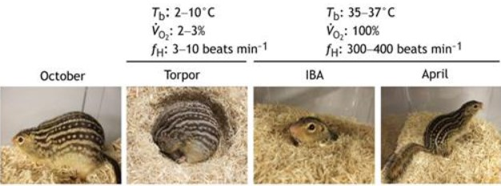
Hibernation and Metabolic in Ground Squirrels Through Mass Spectrometry Analysis and R Data Visualization
Image adapted from Andrews M. T. (2019).

Slide 2
Objectives
The focus is on data analysis and visualization of Mass Spectrometry (MS) data metabolomics analysis.
Identified key metabolites and metabolic pathways activated during hibernation.

Slide 3
Packages Used for plots
(openxlsx)
(ggplot2)
(ggpubr)
(ggthemes)
(Ellipse)
(ggplot)
(gmodels)
(Export)
(tidyverse)

Slide 4
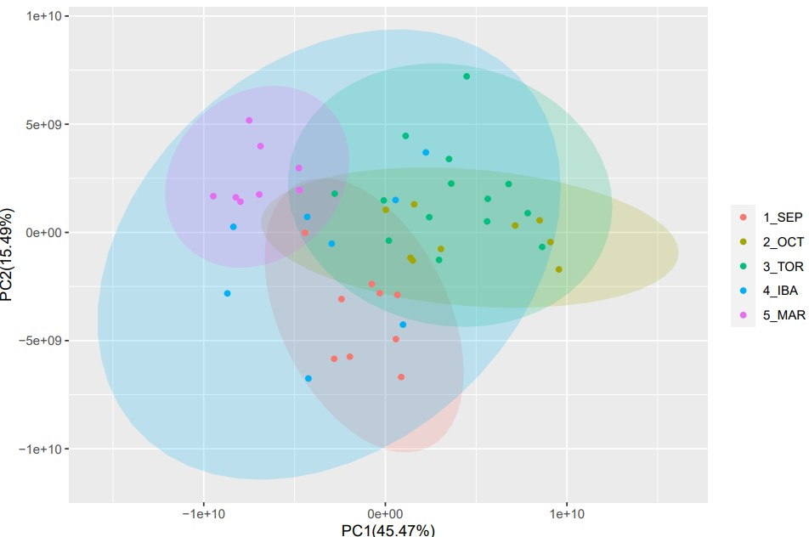
PCA Plot of metabolites

Slide 5
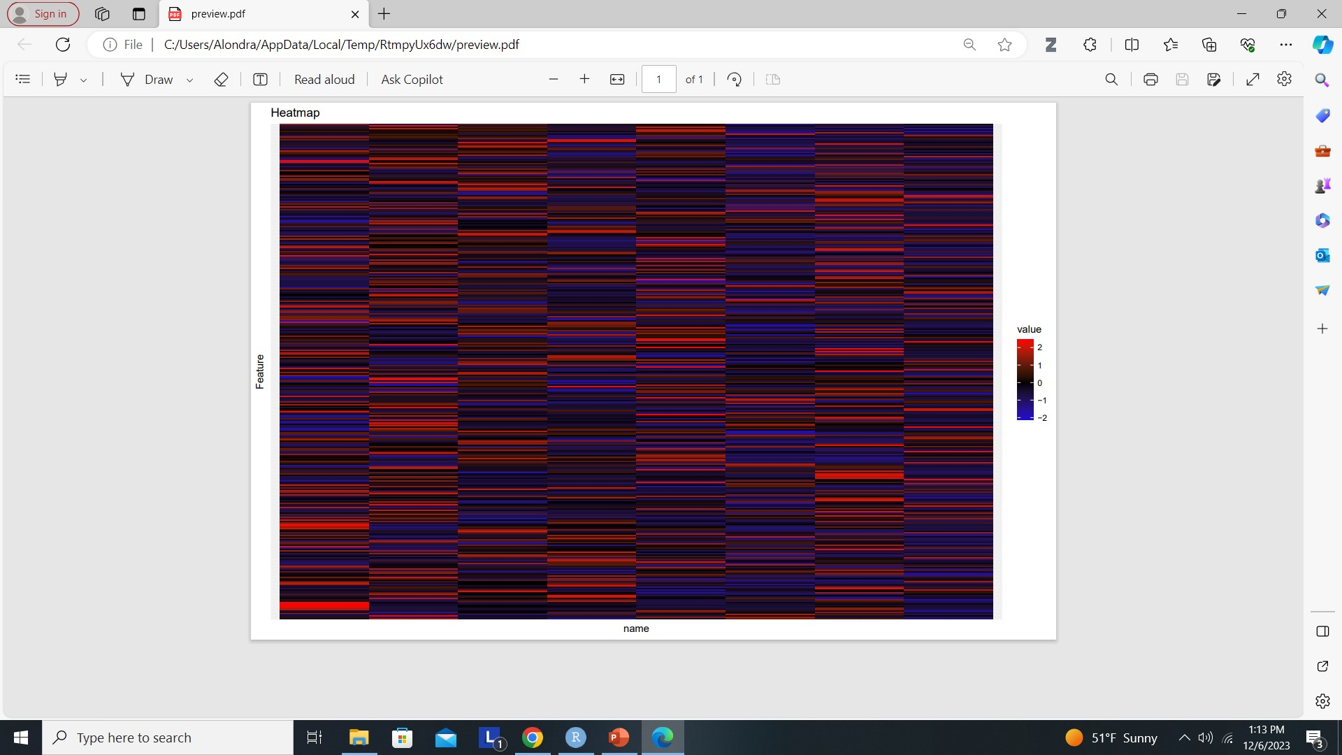
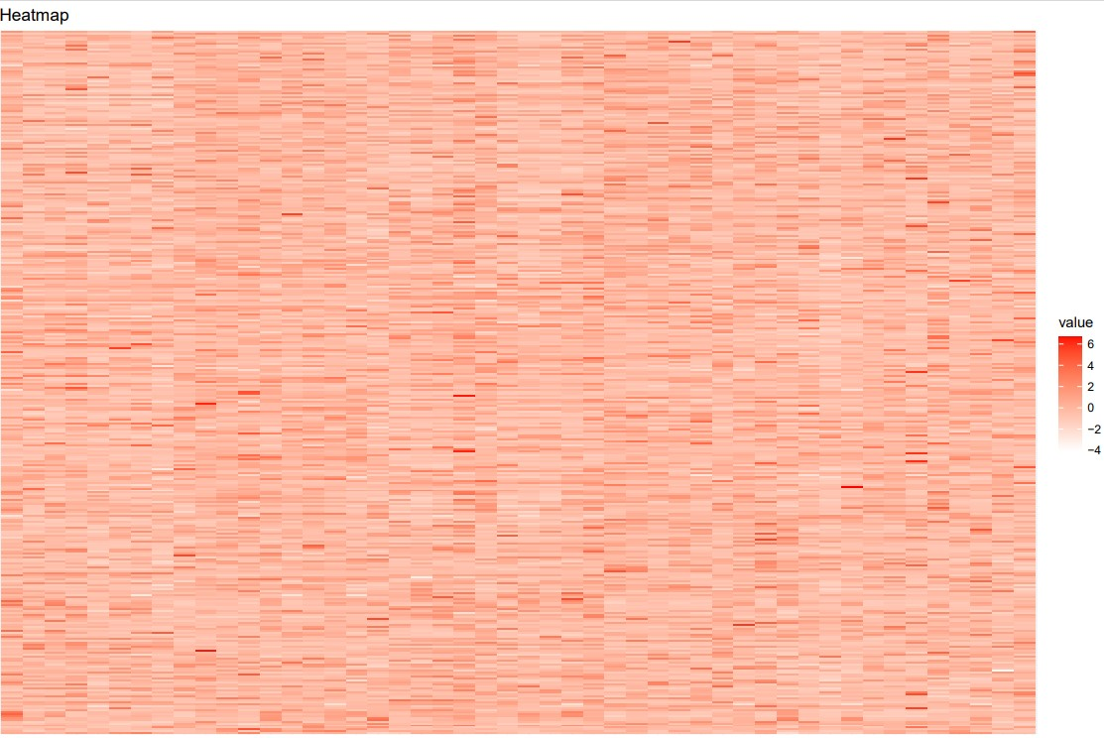
Heatmaps of the different variables
FULL DATA SET
IBA
Metabolites
Metabolites
variable
variable

Slide 6
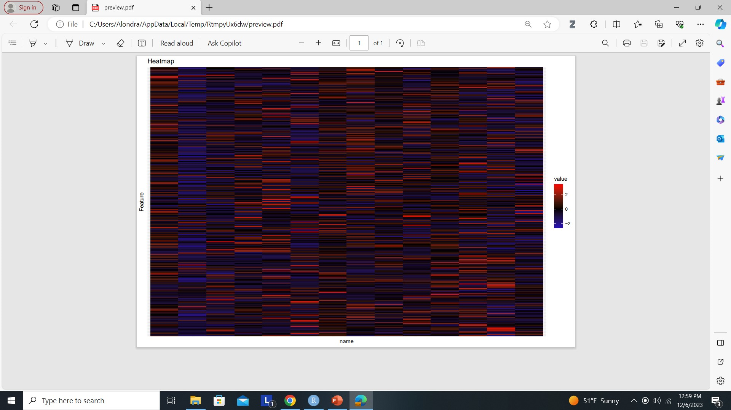
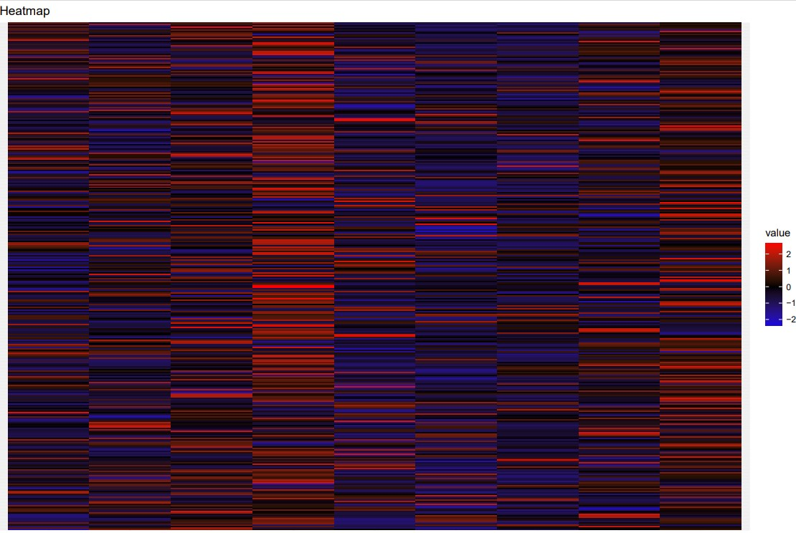
Heatmaps of the different variables
TOR
SEP
Metabolites
Metabolites
variable
variable

Slide 7
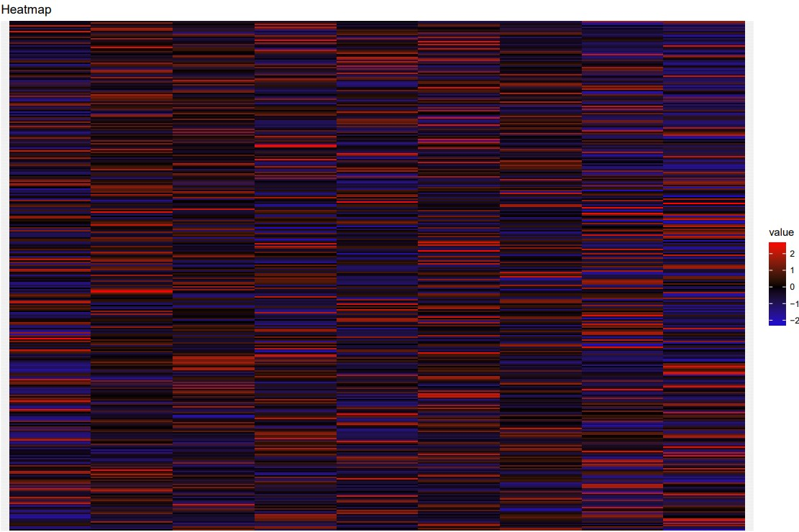
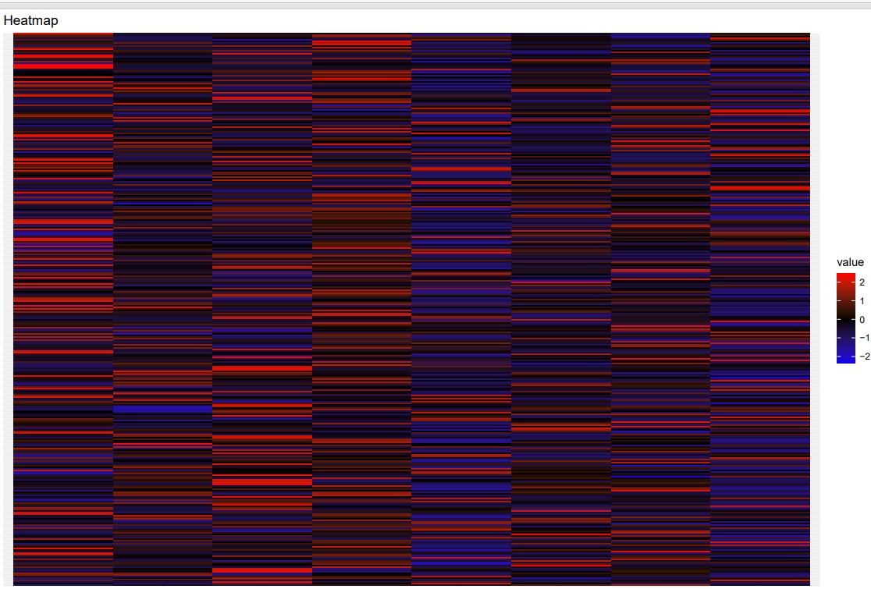
Heatmaps of the different variables
OCT
MAR
Metabolites
Metabolites
variable
variable

Slide 8
Determine top metabolites for the entire dataset
193- ETHANOLAMINE
11- (4S)-4-{[(9Z)-3-Hydroxy-9-hexadecenoyl]oxy}-4-(trimethylammonio)butanoate_1
70-3-Hydroxyhexadecadienoylcarnitine
255- Linamarin
39- 2,3-Bis(octanoyloxy)propanimidic acid
(top_metabolites_IBA)
328-Ritalinic acid
11-(4S)-4-{[(9Z)-3-Hydroxy-9-hexadecenoyl]oxy}-4-(trimethylammonio)butanoate_1
12-(4S)-4-{[(9Z)-3-Hydroxy-9-octadecenoyl]oxy}-4-(trimethylammonio)butanoate
70-3-Hydroxyhexadecadienoylcarnitine
10- (4S)-4-{[(9Z)-3-Hydroxy-9-hexadecenoyl]oxy}-4-(trimethylammonio)butanoate_0
(top_metabolites_MAR)
340-Threonylleucine
332-ser-asn
198-gln-phe
222-Hypoxanthine_3
128-arg-leu
(top_metabolites_OCT)
132-Aspartyl-L-proline
347- uridine 5-diphosphate
91-4-Hydroxyprolylleucine
85-4-[(8-Amino-8-oxo-1-sulfanyl-3-octanyl)sulfanyl]-4-oxobutanoic acid
20-[Similar to: DL-Carnitine; Mass: -0.0906 Da]
(top_metabolites_all)
"193" "11" "70" "255" "39"
(top_metabolites_IBA)
"328" "11" "12" "70" "10"
(top_metabolites_MAR)
"340" "332" "198" "222" "128"
(top_metabolites_OCT)
"132" "347" "91" "85" "20"
(top_metabolites_SEP)
"82" "244" "315" "342" "266"
(top_metabolites_TOR)
"342" "341" "288" "82" "243"

Slide 9
Determine top metabolites for the entire dataset
(top_metabolites_SEP)
82-4-(allyloxy)-1,2-dihydroquinolin-2-one
244- Leucylproline
315- phosphoethanolamine
342-Triethanolamine
266- methionine S-oxide
(top_metabolites_TOR)
342-Triethanolamine
341-trans-3-Indoleacrylic acid
288-N8-Acetylspermidine
82-4-(allyloxy)-1,2-dihydroquinolin-2-one
243-Leucylasparagine

